Slide 2
Azure Deep Dive
Rob Bell

Slide 3
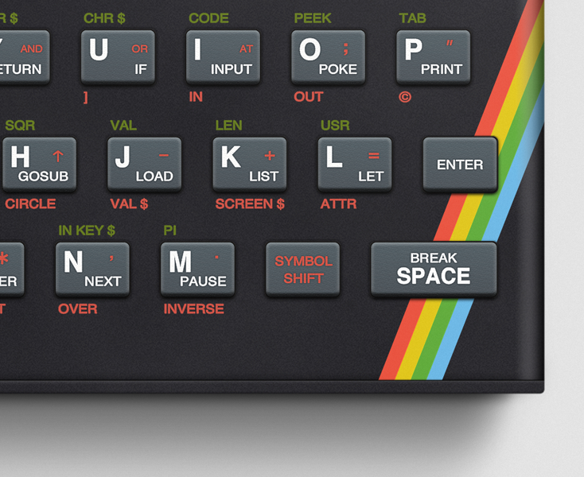
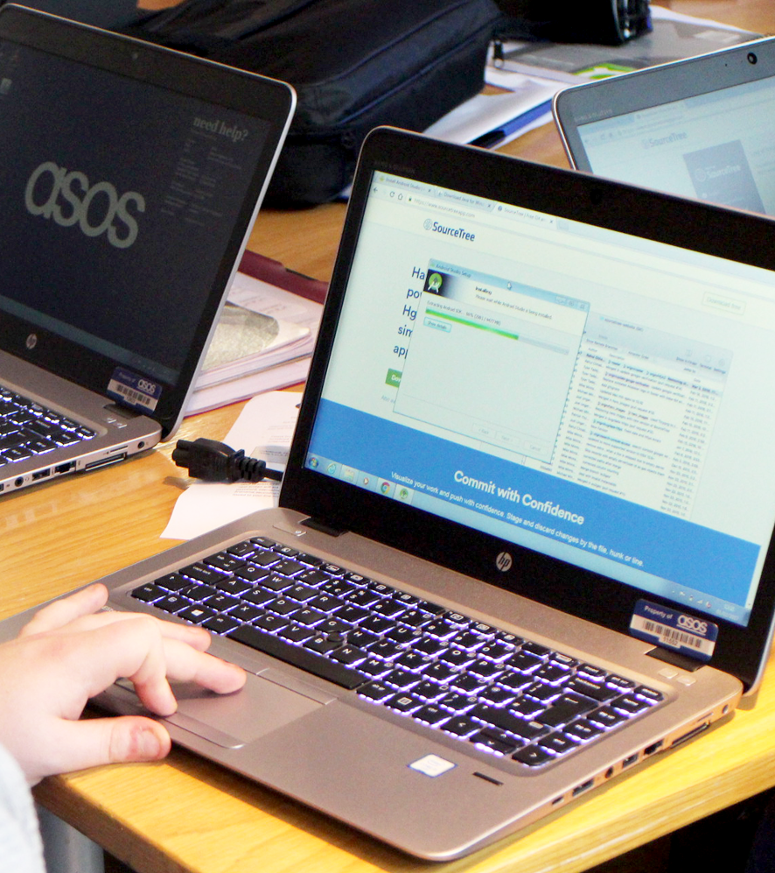
Rob Bell
Lead Software Engineer
Over 20 years writing code and over a decade as a professional developer
First code I wrote was for the ZX Spectrum
After that, I worked my way through the book The C Programming Language
Built HTML web pages in Microsoft Frontpage on my first PC
Since then I’ve written code in C++, Java, JavaScript, PHP, Delphi, Coldfusion, C#, VB, Scheme, F#...
Notes:
Over 20 years writing code and over a decade as a professional developer
I first wrote code for my uncle’s ZX Spectrum, in a language called Basic
I worked my way through the book The C Programming Language, I wrote code samples on pencil and paper as I didn’t have a computer at the time
When I finally did get my first PC, I built web pages in HTML using Microsoft Frontpage
Since then I’ve written code in C++, Java, JavaScript, PHP, Delphi, Coldfusion, C#, VB, Scheme, F#...

Slide 4

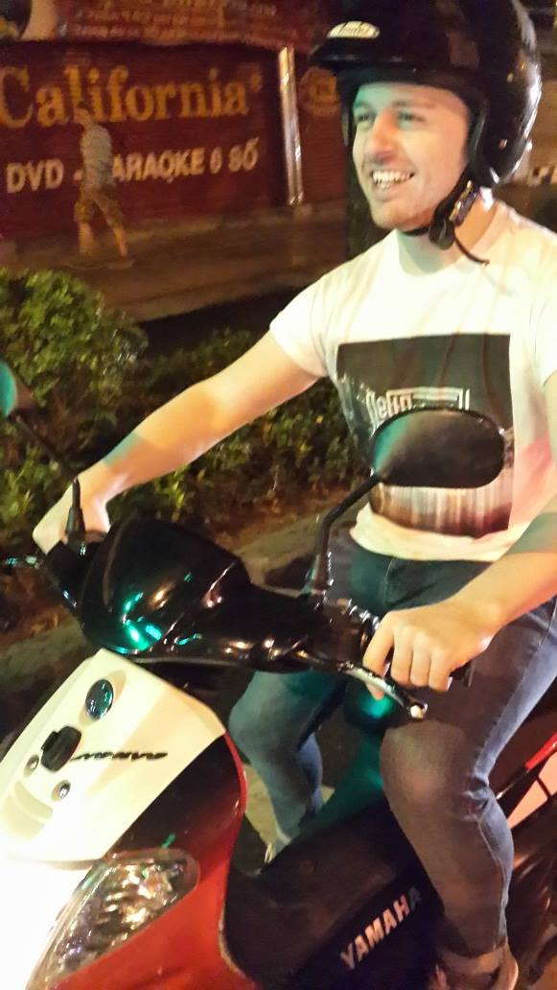
Rob Bell
Lead Software Engineer
My first job as a developer was for a media company, before moving into the insurance and finance sector
Built a software development team in Vietnam
Moved back home and had a brief stint as a technical architect
Moved to ASOS where I work for the Asset and Sizing platforms
Notes:
My first job was for a small media company which was also a charity
Small team of 3 devs, great freedom to build whatever we thought would help the organisation
Podcasting, with audio coming straight from the studios
After that I moved into insurance and finance
Code audits, lots of bureaucracy
After a few years there I got the opportunity to start a development team in Vietnam

Slide 5
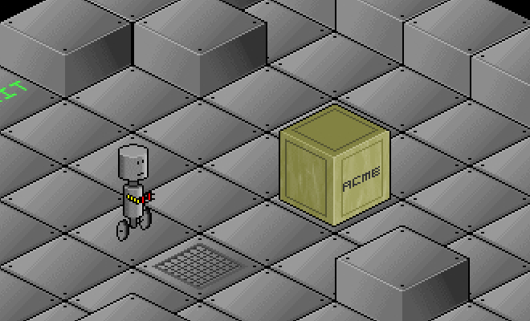
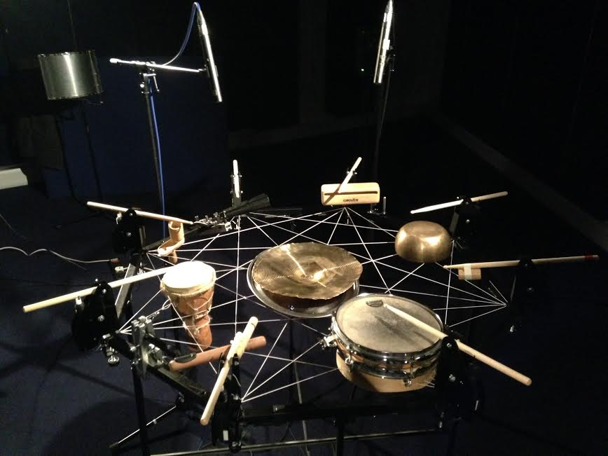
Rob Bell
Lead Software Engineer
In my spare time I’ve built games and I’ve written code to power sound and light installations and robot drum machines
I blog about some of it at rob-bell.net
Notes:
In my spare time I’ve built games and I’ve written code to power sound and light installations and robot drum machines
The game is called Rob-O-Tronic and it’s a slide puzzle, written as part of my dissertation at university
The drum machine was programmed by visiting a website and entering a musical score
It was on display at the Natural History Museum and the V&A
I blog about some of it at rob-bell.net

Slide 6
Azure Resources

Slide 7
Why use the cloud?
“Cloud computing is just using somebody else’s computers”
Notes:
Put the question out to the team
It is correct, but a very simplistic view
Cloud computing provides so much more

Slide 8
Information technology as a utility, not a burden
Notes:
Electricity as an example

